Slide 1
char c1 = 'H';
char c2 = 'I';
char c3 = '!';

Slide 3
H c1 | I c2 | ! c3

Slide 4
72 c1 | 73 c2 | 33 c3

Slide 5
01001000 c1 | 01001001 c2 | 00100001 c3

Slide 6
string

Slide 7
string

Slide 8
string s = "HI!";

Slide 10
H | I s | !

Slide 11
H s[0] | I s[1] | ! s[2]

Slide 12
H s[0] | I s[1] | ! s[2] | 00000000 s[3]

Slide 13
H s[0] | I s[1] | ! s[2] | 0 s[3]

Slide 14
H s[0] | I s[1] | ! s[2] | \0 s[3]

Slide 15
72 s[0] | 73 s[1] | 33 s[2] | 0 s[3]

Slide 16
H s | I | ! | \0

Slide 17
NUL

Slide 18
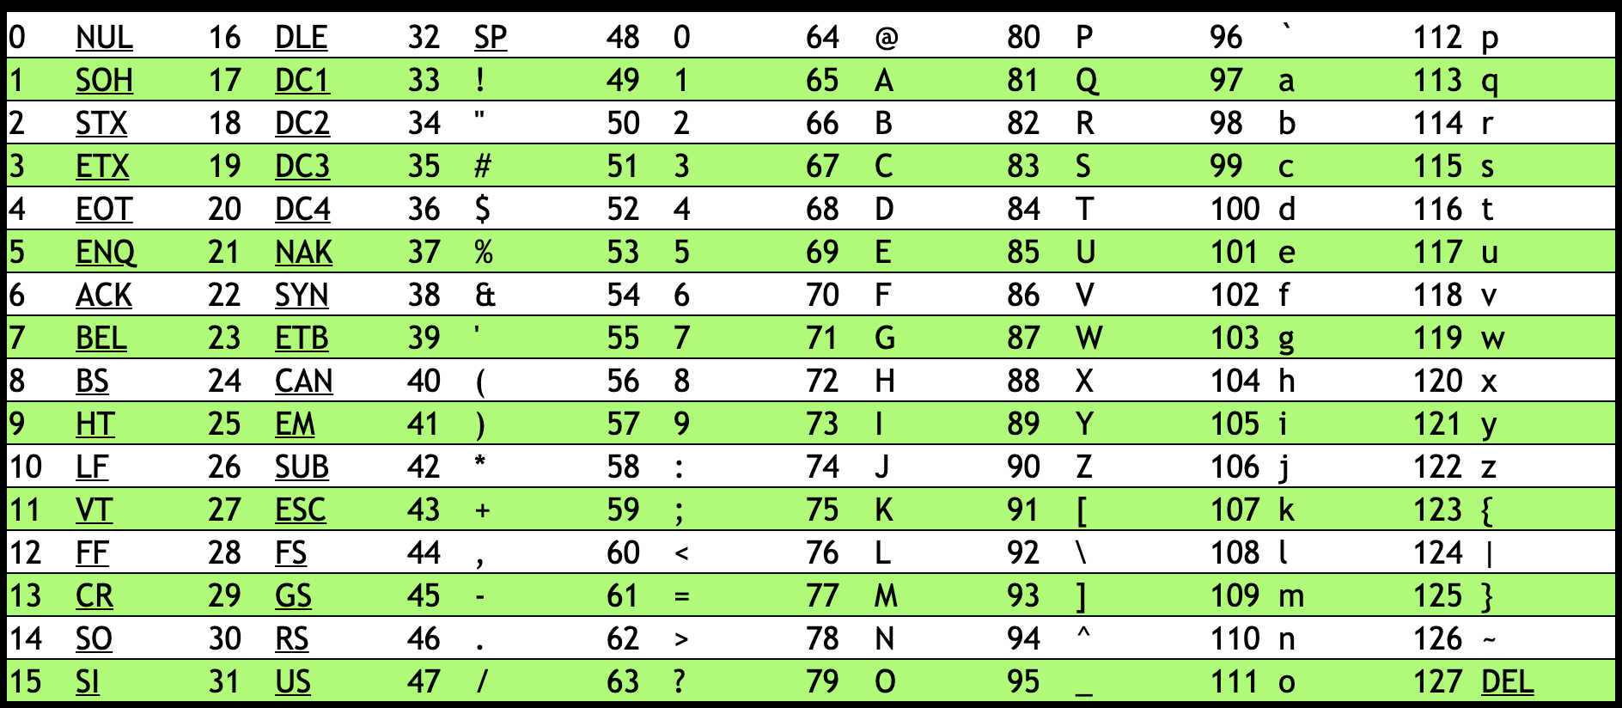

Slide 20
string s = "HI!";
string t = "BYE!";

Slide 22
H s | I | ! | \0

Slide 23
H s | I | ! | \0 | B t | Y | E | !
\0

Slide 24
H s[0] | I s[1] | ! s[2] | \0 s[3] | B t[0] | Y t[1] | E t[2] | ! t[3]
\0 t[4]

Slide 25
string words[2];
words[0] = "HI!";
words[1] = "BYE!";

Slide 26
H words[0] | I | ! | \0 | B words[1] | Y | E | !
\0

Slide 27
H words[0][0] | I words[0][1] | ! words[0][2] | \0 words[0][3] | B words[1][0] | Y words[1][1] | E words[1][2] | ! words[1][3]
\0 words[1][4]

Slide 28
string

Slide 29
string.h

Slide 30
manual.cs50.io/#string.h

Slide 31
strlen

